Slide 1
Ironhack
Project 1
13.10.20 – 17.10.20
Shinan & Benedikt

Slide 2
Topic
Analysis of correlation between Covid-19 related keywords in Google Trends and their impact on stock prices in Germany

Slide 3
What
Did
We do?
We scraped Corona related search terms from Google trends via Google Trends API on a daily basis in Germany in 2020
We scraped Dax Index Value via Alpha Vantage API on a daily basis in 2020
We used a CSV file to get new Covid 19 cases & new deaths due to Covid 19 on a daily basis

Slide 4
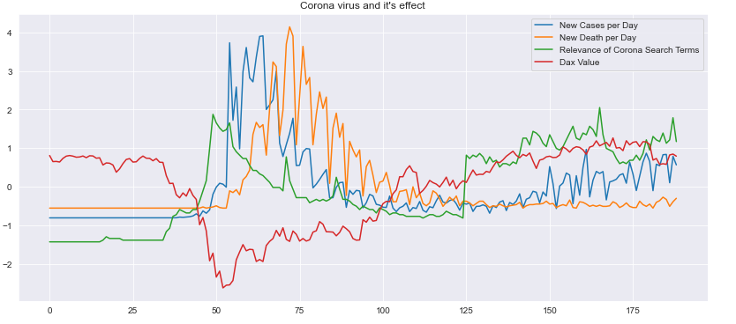
Results

Slide 5
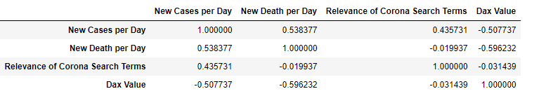
Results
Positive correlation between the amount of cases per day and relevance of Corona related search terms in the Google trends
Negative correlation between the amount of cases per day and Dax Performance
Weak negative correlation between DAX Performance and relevance of Corona related search terms in the Google trends
Relevance of Corona related search terms in the Google trends increases before cases increase and reduces before cases reduce. This seems counter-intuitive.

Slide 6
What
Challenges Did we Face?
Challenge 1: From the website Finanzen, we would like to have the daily price of shares contained in DAX from 01.01.20 to 30.09.20. After we selected the time period online and did the web scraping, the pricing table presented in Jupyter Notebook is only one day and still asking to select the time period. à the html text does not show any share price regards to the required period.
Solution Find stock API Alpha Vantage to get daily share price

Slide 7
Challenge 2: One of the argument in the API is symbol (how to identify the individual stock). Therefore we created a list with all the symbols of all 30 shares, applied it into the API. The issue is that for many individual stocks, we don‘t have any daily data. After digging further, we realized that the API retrieved data probably from US stock exchange and our ticker list with the symbol is used in German stock exchange. Some tickers are probably slight different in different stock exchanges and which lead to the no data found.
Solution We decided to use DAX index instead of getting all the individual share in DAX.
What
Challenges Did we Face?

Slide 8
Thanks
Shinan & Benedikt

